Slide 1
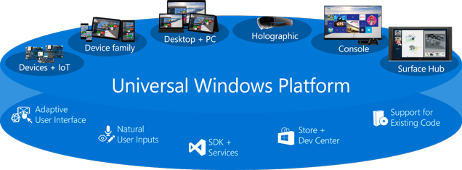
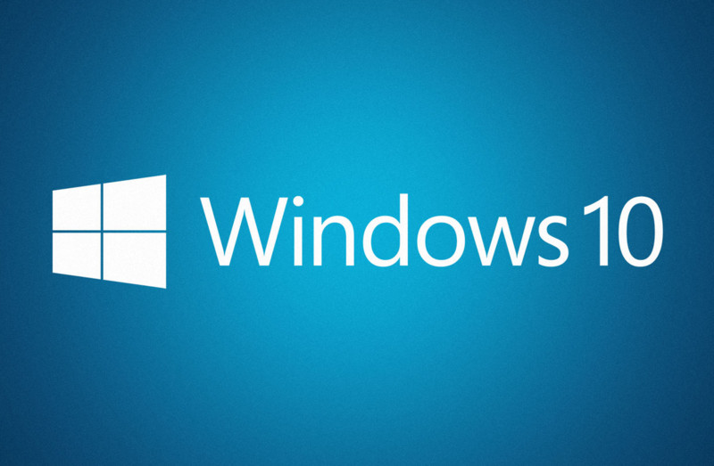
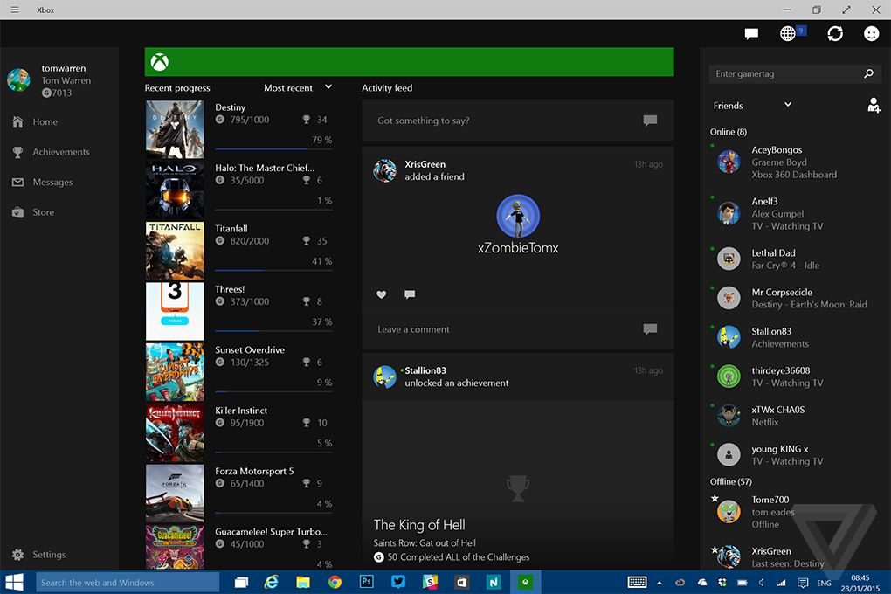
Windows 10 and Universal Windows Platform (UWP)
What is new in the Mobile and Desktop world of Microsoft?
Windows Applications for Mobile
Telerik Software Academy
http://academy.telerik.com

Slide 2
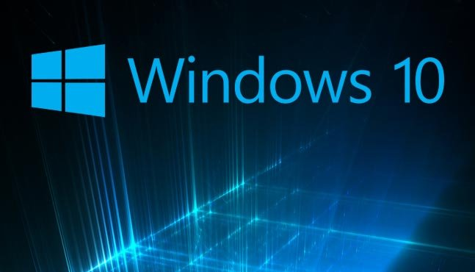

Table of Contents
Windows 10 – the Converging OS
What is new in Windows 10 for Users and Developers?
The Universal Windows Platform (UWP)
Dissecting UWP Applications
Demo: Create Our First Universal Windows Platform Application

Slide 3
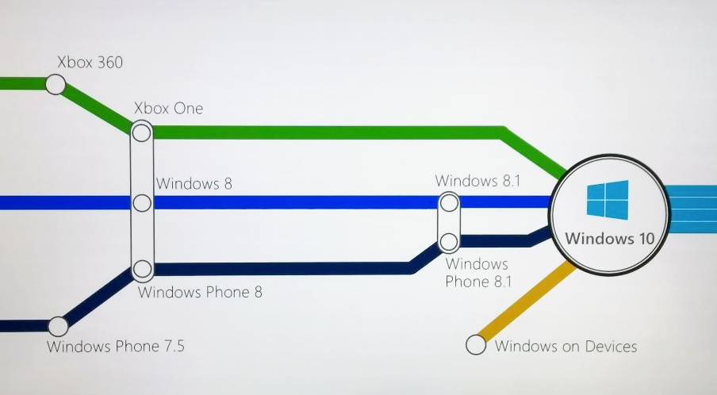
Windows 10 – the Converging OS

Slide 4
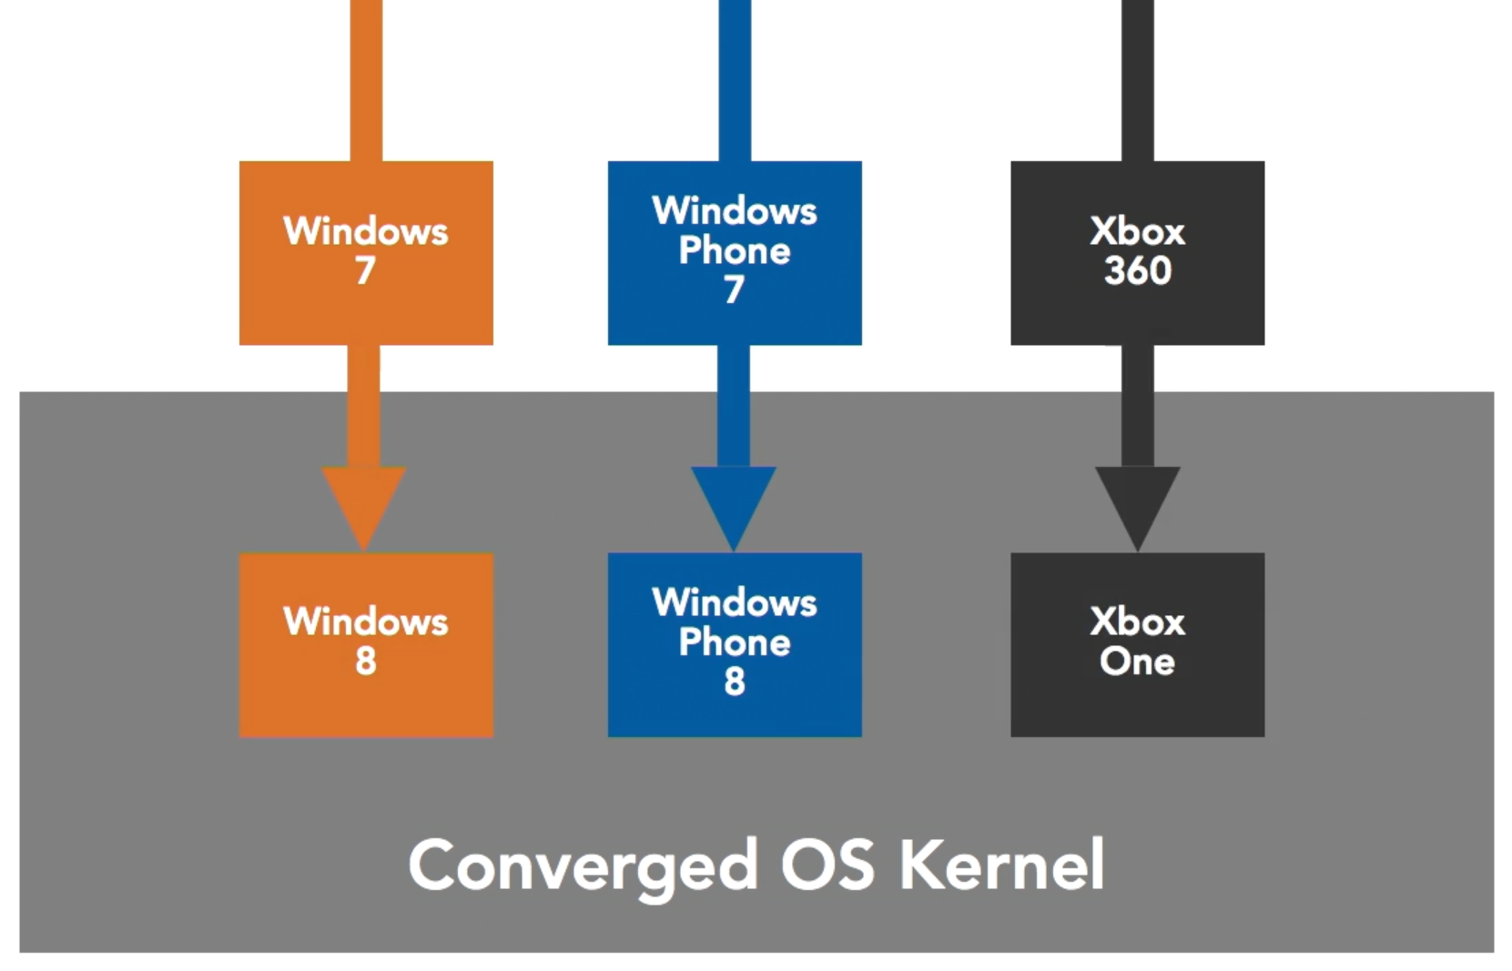
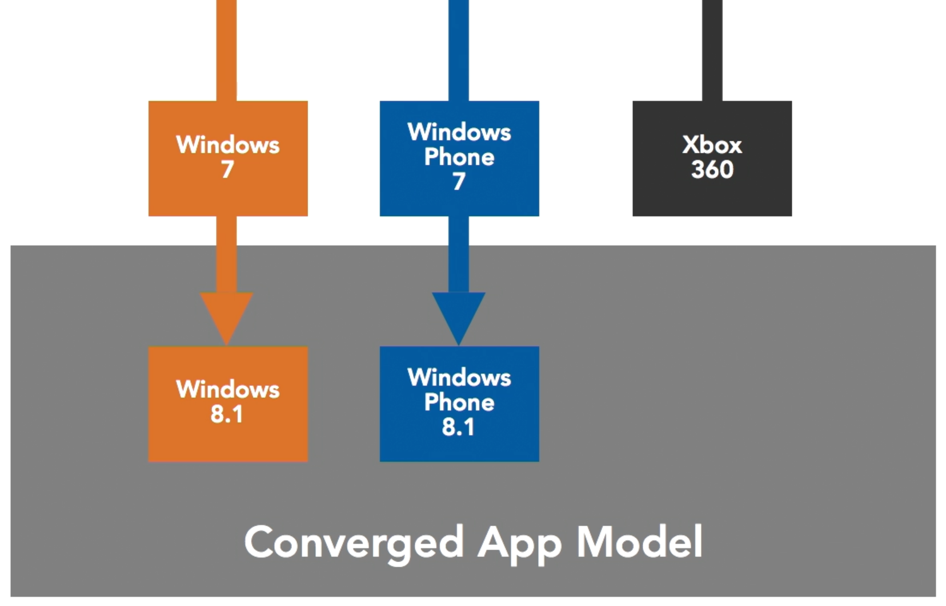
Converge to a Unified System
A long-term Microsoft goal
Create a universal unified system
In the Windows 8 – shared OS kernel
In the Windows 8.1 – shared application code

Slide 5
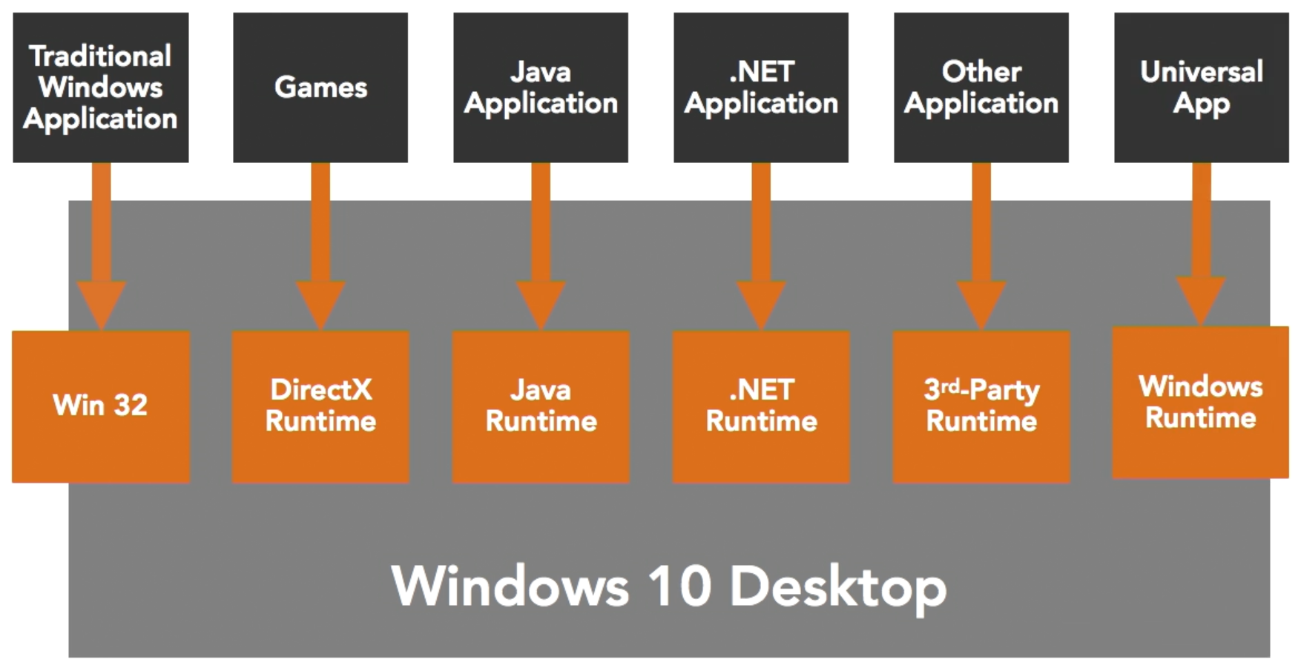
Windows 10
Continued Support for Legacy Code and Apps

Slide 6
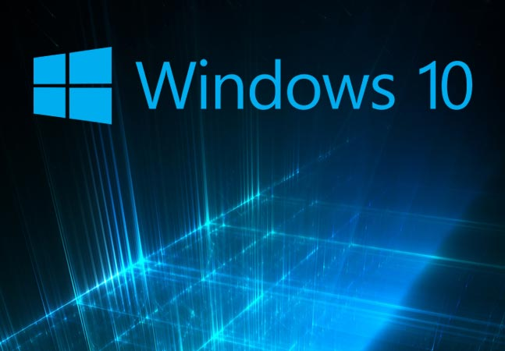
What is new in Windows 10 for Users and Developers?

Slide 7
What is New in Windows 10 for Users?
Cortana – personal digital assistant
Windows Hello – automatic recognizes you
Microsoft Edge – brand new web browser
New Application Features – touch first, fast fluid, modern applications (including Office)
Xbox Live on Windows
More info:
https://youtube.com/watch?v=Wwc5jKc-EgE

Slide 8
What is New in Windows 10 for Developers?
One codebase for Universal Windows apps
Integration within the Windows Stores
Touch-based interaction
Better multi-monitor support
Continuum for Windows Phone
Action Center and Notifications
Speech commands and Cortana

Slide 9
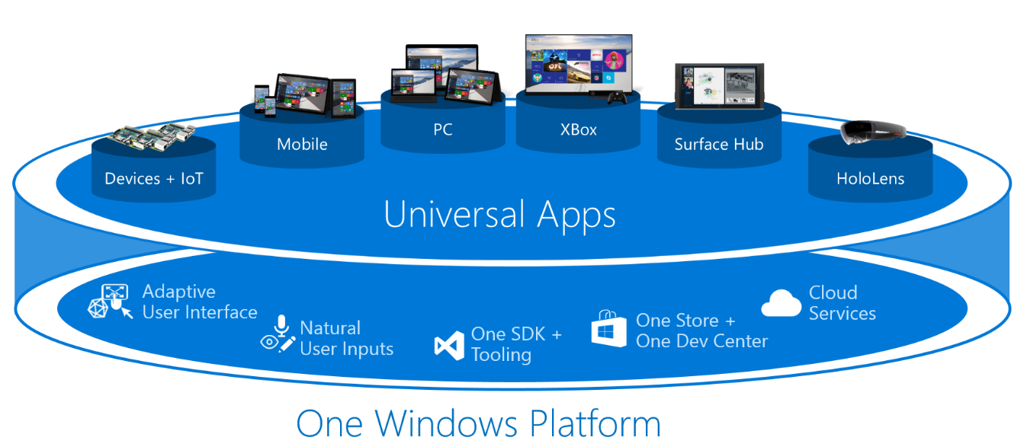
One Codebase
One codebase can run in Desktops, Xbox One, Tablets, Windows Phones, HoloLens and Embedded Devices (Raspberry Pi)

Slide 10
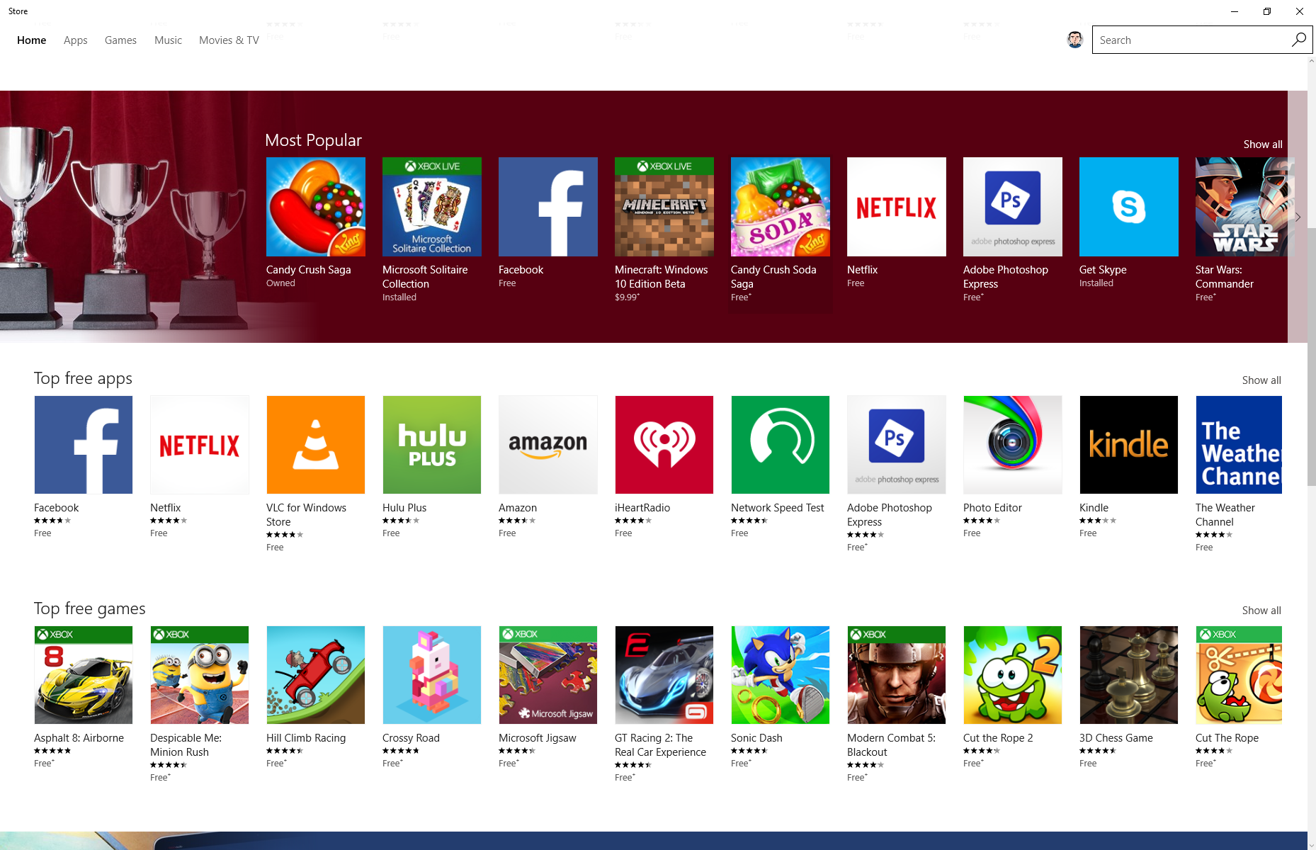
Windows 10 Store
Universal store across all devices where you can distribute and sell your app in 190 countries

Slide 11
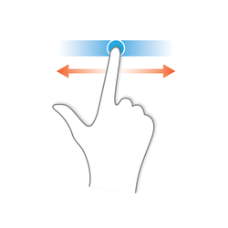
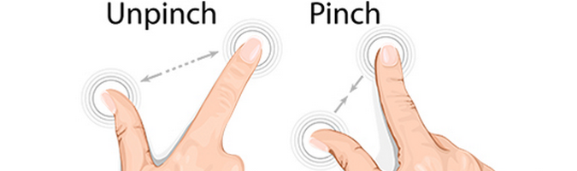
Touch Interaction
If the client machine has touch support – your application adjust itself to be touchable
The buttons and icons get bigger for better support of finger sizes
OS understands pinch, zoom and swipe gestures (your app just works)

Slide 12
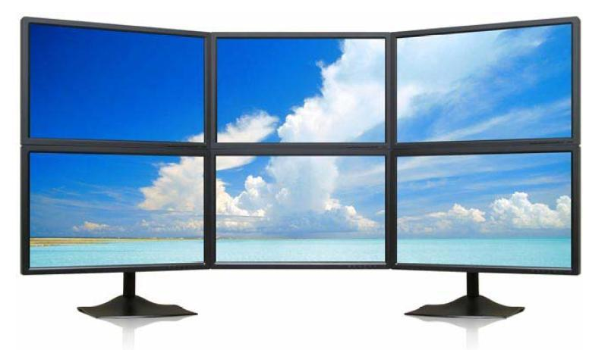
Improved Multi-Monitor Support
Windows 8.1 and 10 provide support for multi-monitor without the need of 3rd party software
Per-monitor DPI scaling for different resolution
Attach low resolution tablet to bigger monitor
Increased usability with mixed screen sizes

Slide 13
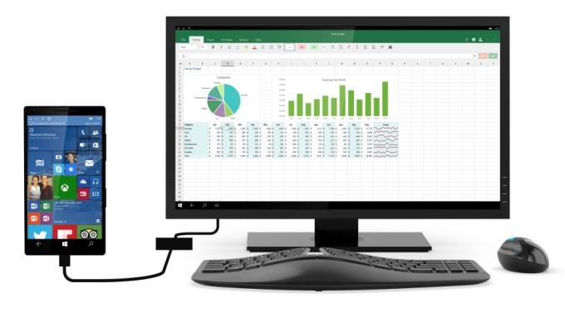
Continuum for Windows Phone
Windows 10 phones can also be PCs
Just add a display, and keyboard (and mouse?)
Win 10 includes a feature called Continuum that allows the same device to be used in different modes: youtube.com/watch?v=-oi1B9fjVs4

Slide 14
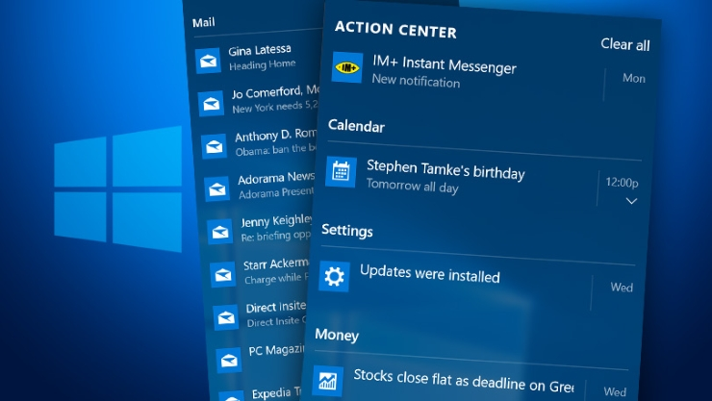
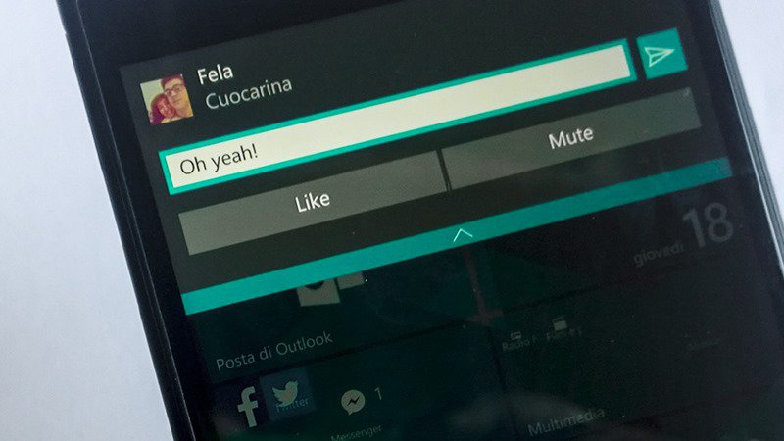
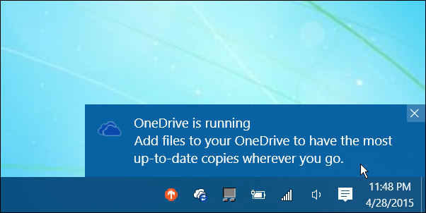
Action Center and Notifications
Action Center
Notifies users about new activities
Your app can also add items in it
Notifications
Inform users for important app messages

Slide 15

Speech and Cortana
Cortana app integration via commands
You can use Cortana to call app commands
https://youtube.com/watch?v=CUmXFy3xzc0
UWP enables text dictation using speech recognition to convert spoken words into text
Speech synthesis, or text-to-speech (TTS), can convert text back into spoken words

Slide 16
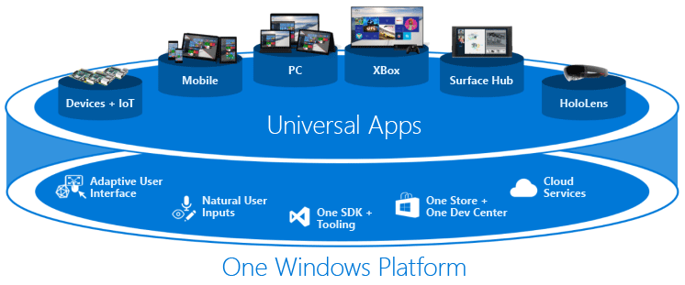
The Universal Windows Platform (UWP)

Slide 17
UWP Concepts
Universal runtime
Works across all devices
Universal app model
Same code for all devices
Universal developer portal
Shared dev portal for managing apps, ads, monitoring app crashes (application insights)
Universal store
For distributing and selling your apps

Slide 18
Universal Windows Platform
Core library – tiny API that contains features that work across any Windows 10 device
E.g.: read/write to the file system
Windows 8/8.1 added 6100 new classes and types into the .NET Framework
Windows 10 added another 2500 more
DirectX 12, holographic displays, active pen, windows hello, etc.
.NET and COM were enhanced too

Slide 19
Core library
File I/O
(local and OneDrive)
Network
(networks and Internet)
Media
(video, music, cameras)
Security
(authentication)
Push Notifications
Toast Notifications
Live Tiles
Touch
(gestures)
Ink
(handwriting)
Fluid UX
(adaptive UI)
Speech Cortana
Async Everywhere…
Windows Notifications
Roaming Data
Application Telemetry
Animations
Application Settings
App Suspend / Resume
Globalization Localization
UI Controls
And many more…

Slide 20
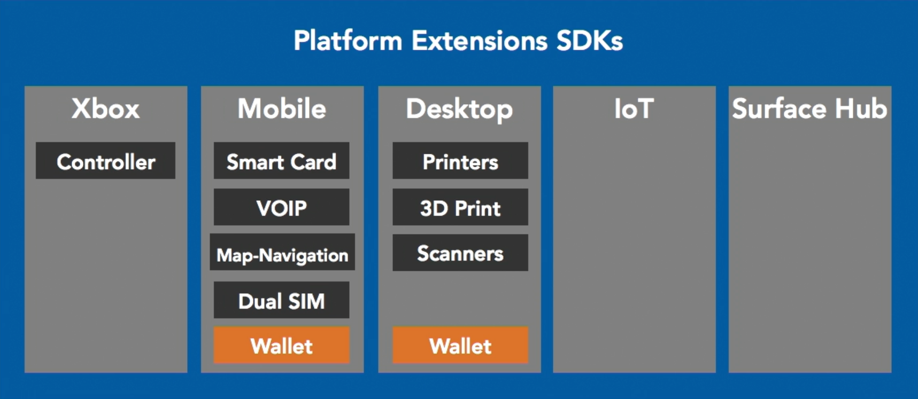
Platform Extensions SDKs
Several platforms have Extension SDKs
Can be added to your app to take advantage of platform specific behaviors

Slide 21
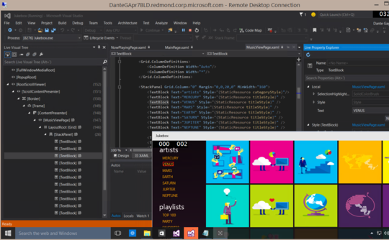
Dissecting UWP Applications

Slide 22
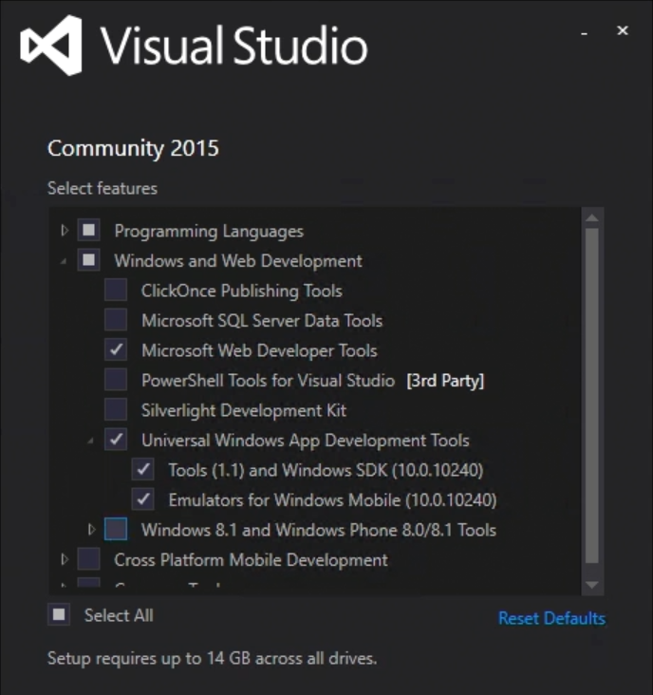
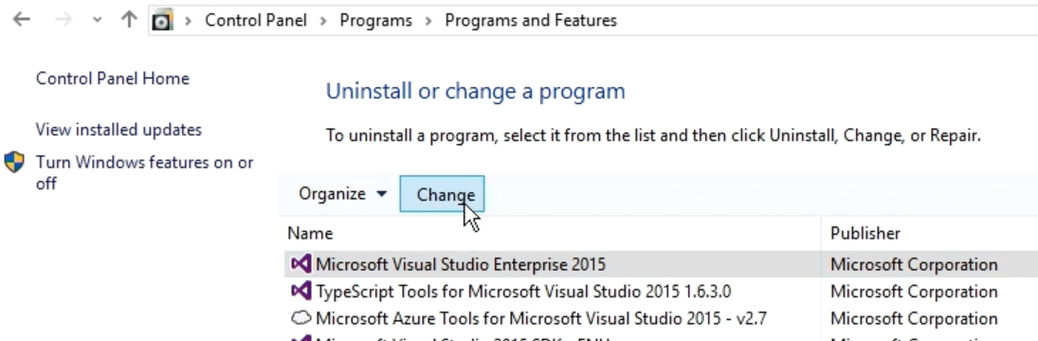
Getting Ready for UWP
Install Windows 10
With latest updates
Install Visual Studio 2015
Free edition – Community
With "Update 1"
Universal Windows App Development Tools
If you have VS 2015 just add features in it
Optional: Blend for Visual Studio

Slide 23
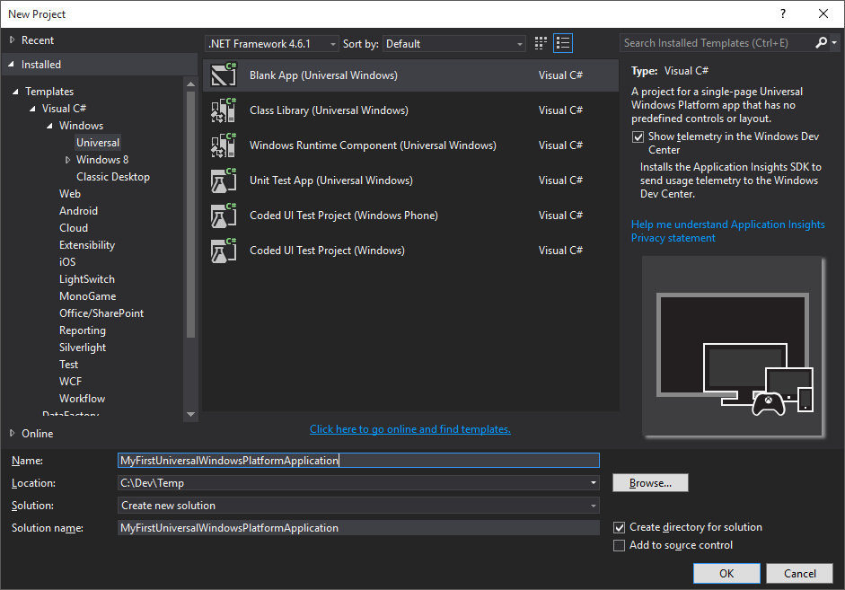
Demo: Create Our First UWP App (Choose between 4 languages C#, VB.NET, C++ and JavaScript)

Slide 24
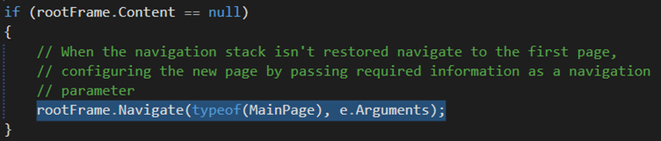
Dissecting UWP Applications
Where is the well-known Main() method?
It is auto-generated from App.xaml.cs
Located in "obj\x86\Debug\App.g.i.cs"
What is App.xaml.cs file?
App.xaml.cs extends the Application class
The place to subscribe to important app events, like application start, unhandled exceptions, etc.
The C# code-behind file for App.xaml

Slide 25
Dissecting UWP Applications (2)
What is the App.xaml file?
Declarative starting point of your application
Most commonly used to define global resources
E.g. global styles
So where is my application UI and logic?
In MainPage.xaml and MainPage.xaml.cs
<Application
x:Class="MyFirstUniversalWindowsPlatformApplication.App"
xmlns="http://schemas.microsoft.com/winfx/2006/xaml/presentation"
xmlns:x="http://schemas.microsoft.com/winfx/2006/xaml"
xmlns:local="using:MyFirstUniversalWindowsPlatformApplication"
RequestedTheme="Light">
</Application>

Slide 26
XAML
Extensible Application Markup Language (XAML) is an XML-based markup language developed by Microsoft
XAML can initialize objects and set properties of objects declaratively
Hierarchical relationships between multiple objects
.xaml file extension
Part of a separate code-behind file (C#, JS, C++)
To respond to events and manipulate the objects you declare in XAML

Slide 27
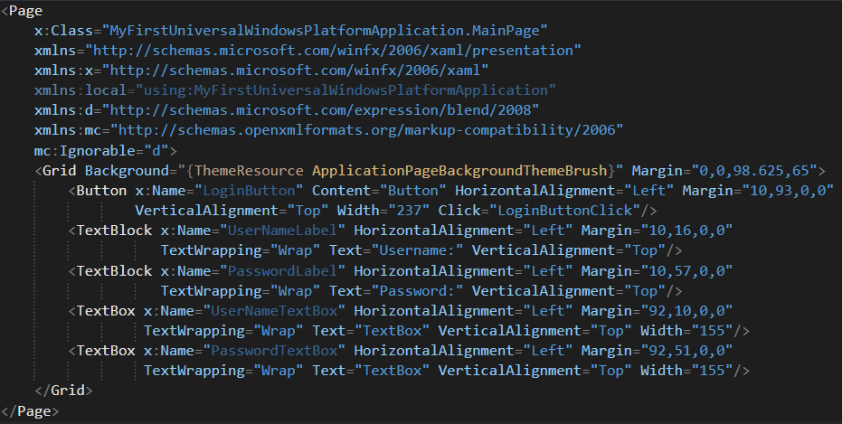
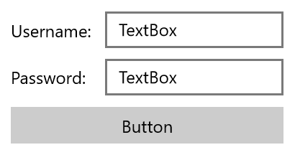
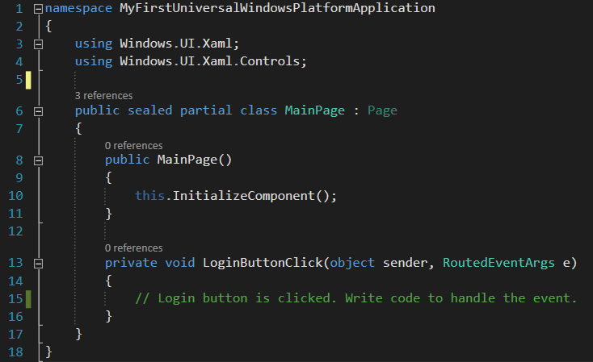
Example of a UWP Page

Slide 28
Demo: Create a Simple A+B Calculator with UWP and Run It In Windows 10 Mobile Emulator

Slide 29
More on XAML and UWP
You can choose from many built-in controls
Lots of other free and paid controls also available
You can create your own custom user controls
Reusable components (<UserControl>)
Automatic data-bindings
Dependency and attached properties
Supports styles and templates (resources)
MVVM is the right way to construct big apps
Easy navigation through different pages
You can use and create animations

Slide 30

Windows 10 and Universal Windows Platform (UWP)
Questions?

